Slide 1

An Introduction to Statistics and Research Design
Chapter 1

Slide 2
Two Branches of Statistics
Descriptive statistics
Organize, summarize, and communicate numerical information
Inferential statistics
Use representative sample data to draw conclusions about a population

Slide 3
Branches of Statistics
Descriptive: M = 80.2, SD = 4.5
Describes the average score on the first test
Inferential: t(45) = 4.50, p = .02, d = .52
Infers that this score is higher than a normal statistics average

Slide 4
Samples and Populations
A population is a collection of all possible members of a defined group
Could be any size
A sample is a set of observations drawn from a subset of the population of interest
A portion of the population
Sample results are used to estimate the population

Slide 5
Samples and Populations
So, why would we use samples rather than test everyone?
What would be more accurate?
What would be more efficient?

Slide 6
Statistics = Numbers
Mostly, statistics is all about numbers.
So … how can we make these observations into numbers?
Think about all the different types of things you can measure…

Slide 7

Variables
Variables
Observations that can take on a range of values
An example: Reaction time in the Stroop Task
The time to say the colors compared to the time to say the word

Slide 8
Types of Variables
Discrete
Variables that can only take on specific values
Number of students
Tricky part … we can assign discrete values to things we’d normally consider words.
Political party

Slide 9
Types of Variables
Continuous
Can take on a full range of values (usually decimals)
How tall are you?

Slide 10
More Classification of Variables
Discrete Variables
Nominal: category or name
Ordinal: ranking of data

Slide 11
More Classification of Variables
Continuous Variables
Interval: used with numbers that are equally spaced
Ratio: like interval, but has a meaningful 0 point (absence of the thing you are measuring)
Generally described as scale variables

Slide 12
Examples of Variables
Nominal: name of cookies
Ordinal: ranking of favorite cookies
Interval: temperature of cookies
Ratio: How many cookies are left?

Slide 13
A distinction
The previous information talks about the type of number you have with your variable.
This type leads to the type of statistical test you should use

Slide 14
Variables
Independent Variables (IVs)
Variable you manipulate or categorize
For a true experiment: must be manipulated – meaning you changed it
Generally dichotomous variables (nominal) like experimental group versus control group
For quasi experiment: used naturally occurring groups, like gender
Still dichotomous, but you didn’t assign the group

Slide 15
Variables
Independent Variables
Special case: when IVs are categorical, the groups are called levels
If political party is an IV, levels could be Democrat or Republican

Slide 16
Variables
Dependent Variables (DVs)
The outcome information, what you measured in the study to find differences/changes based on the IV
Generally, these are interval/ratio variables (t-tests, ANOVA, regression), but you can use nominal ones too (chi-square)

Slide 17
Variables
Confounding Variables
Variables that systematically vary with the IV so that we cannot logically determine which variable is a work
Try to control or randomize them away
Confounds your other measures!

Slide 18
Reliability and Validity
A reliable measure is consistent
Measure your height today and then again tomorrow
Standardized tests are supposed to be reliable

Slide 19
Reliability and Validity
A valid measure is one that measures what it was intended to measure
A measuring tape should accurately measure height
A good variable is both reliable and valid
How do we measure this?

Slide 20

Rorschach Personality Test
Reliability of the Roschach inkblot test is questionable
Makes validity of the information it produces is difficult to interpret
Notes:
*measure can be reliable without being valid
*measure cannot be valid without being reliable

Slide 21
Hypothesis Testing
Process of drawing conclusions about whether a relation between variables is supported (or not supported) by the evidence

Slide 22
Assessing Variables
Back to … how do we assign numbers to things?
Operational definitions
This number assigning is important for using statistical programs (like JASP)

Slide 23
Assessing Variables
Operational definition
How to measure or detect variable of interest
Depression:
Diminished interest in activities
Significant weight loss/gain
Fatigue (loss of energy)
Feelings of worthlessness
Recurrent thoughts of death or suicide

Slide 24
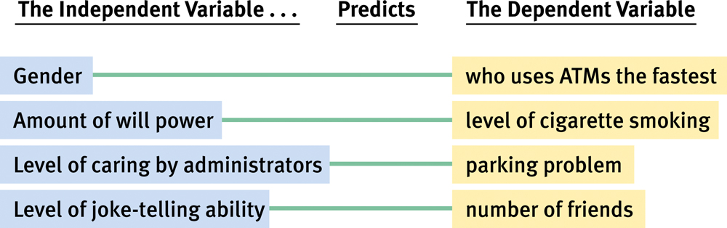
Developing Research Hypotheses

Slide 25
Types of Research Designs
Experiments: studies in which participants are randomly assigned to a condition or level of one or more independent variables

Slide 26
Experiments and Causality
Experiments: able to make causal statements
Control the confounding variables
Importance of randomization

Slide 27
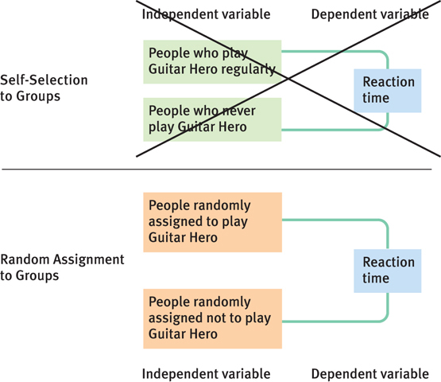
Figure 1-3:
Self-Selected into or Randomly Assigned to One of Two Groups: Guitar Hero Players vs. Non-Guitar Hero Players

Slide 28
One Goal, Two Strategies
Between-groups designs
Different people complete the tasks, and comparisons are made between groups
Within-groups designs
The same participants do things more than once, and comparisons are made over time

Slide 29
Other Research Designs
Not all research can be done through experimentation
Unethical or impractical to randomly assign participants to conditions
Correlational studies do not manipulate either variable
Measure associations between variables
Variables are assessed as they exist
Cannot determine causality

Slide 30
Correlational Analysis
Video game playing and aggression are related
No evidence that playing video games causes aggression

Slide 31
Outlier Analysis
Outlier: an extreme score - very high or very low compared to the rest of the scores
Outlier analysis: examination of observations that do not fit the overall pattern of the data, in an effort to understand the factors that influence the DV

Slide 32
Recap
Operational definitions – ways to assign numbers to variables that determine their scale (dichotomous/continuous)
Types of variables – describe how they were used in an experiment (IV/DV)
Types of research – further explain the workings of the IV/DV (exp/quasi/correl)
All of these are tied to an appropriate type of statistic

